Slide 1
Dominion Energy Virginia reliability review
What public data shows about outages, weather and demand, and where I would look first
Saketh Bollina
Panel discussion, November 3, 2026
Independent analysis of public data: EIA-861 (via PUDL), NOAA Storm Events, EIA-930.
Notes:
Good morning. Before coming in I wanted to understand what Dominion is measured on, so I rebuilt the reliability figures from public filings and asked one question: was 2025 a worse year for customers, and is service getting worse over time. Everything here is public data. I will walk through what I found in about six minutes and then I am happy to go anywhere you like, including the SQL and the Power BI model behind it.

Slide 2



Beyond the SAIDI headline: what is driving the change in reliability?
Independent analysis of public reliability, weather and electricity demand data
Three questions investigated
REPORTED THREE-YEAR AVERAGE SAIDI
130 to 133
Are customers experiencing more interruptions or longer outages?
How is storm exposure associated with reliability performance?
Minutes per customer, excluding major event days
The observation that prompted the analysis
How are electricity demand patterns changing on the same system?
Purpose: move beyond reporting a KPI to identifying where further operational investigation could create value
Sources: EIA-861 (via PUDL) 2013 to 2025, NOAA Storm Events 2013 to 2025, EIA-930 hourly demand 2018 to 2026. Reported figure: Dominion Energy 2025 Annual Report. Reconciliation of the three-year average in Appendix 6.
2
Notes:
The annual report says the rolling three-year average went from about 130 to 133 minutes per customer. I rebuilt it from EIA-861 and got 130.2 and 133.0, so the public data is good enough to work with. That number was the starting point, not the finding. Three questions came out of it. Are customers losing power more often or for longer. How does storm exposure relate to the numbers. And what is happening to the demand the same system carries. The purpose was to get past reporting a KPI to where an operational investigation would be worth the effort. If anyone wants the arithmetic of the rolling average, it is in the appendix.

Slide 3
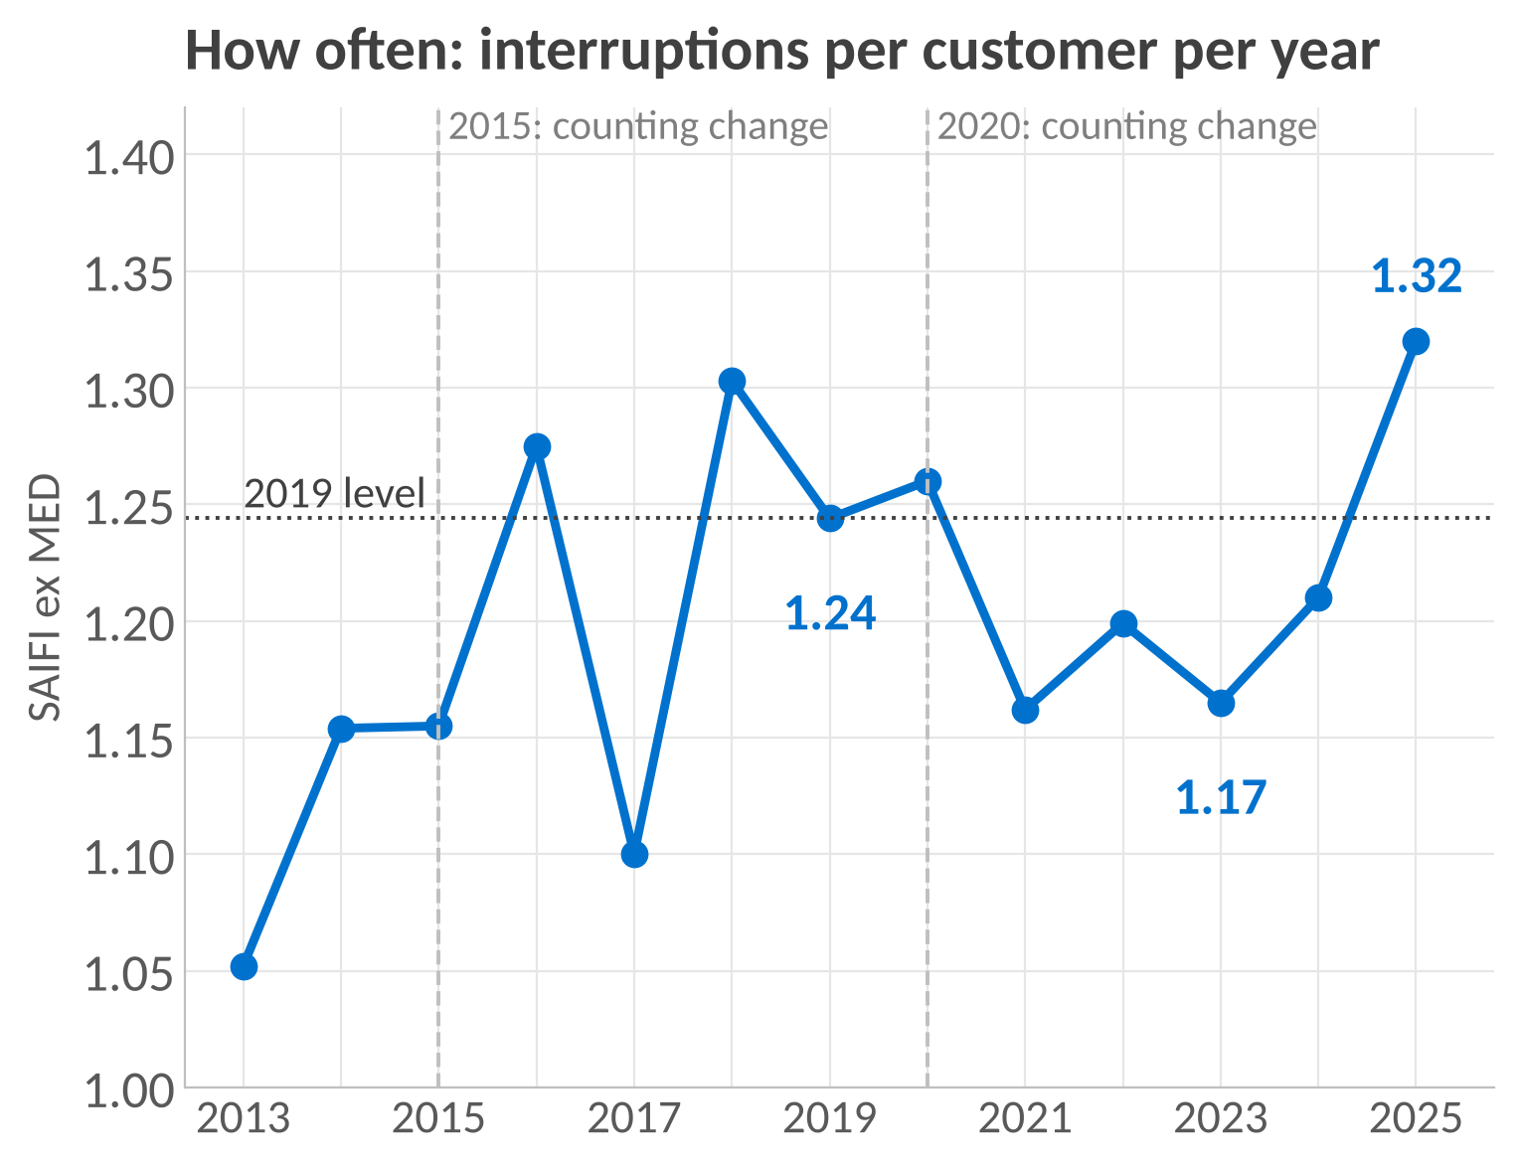
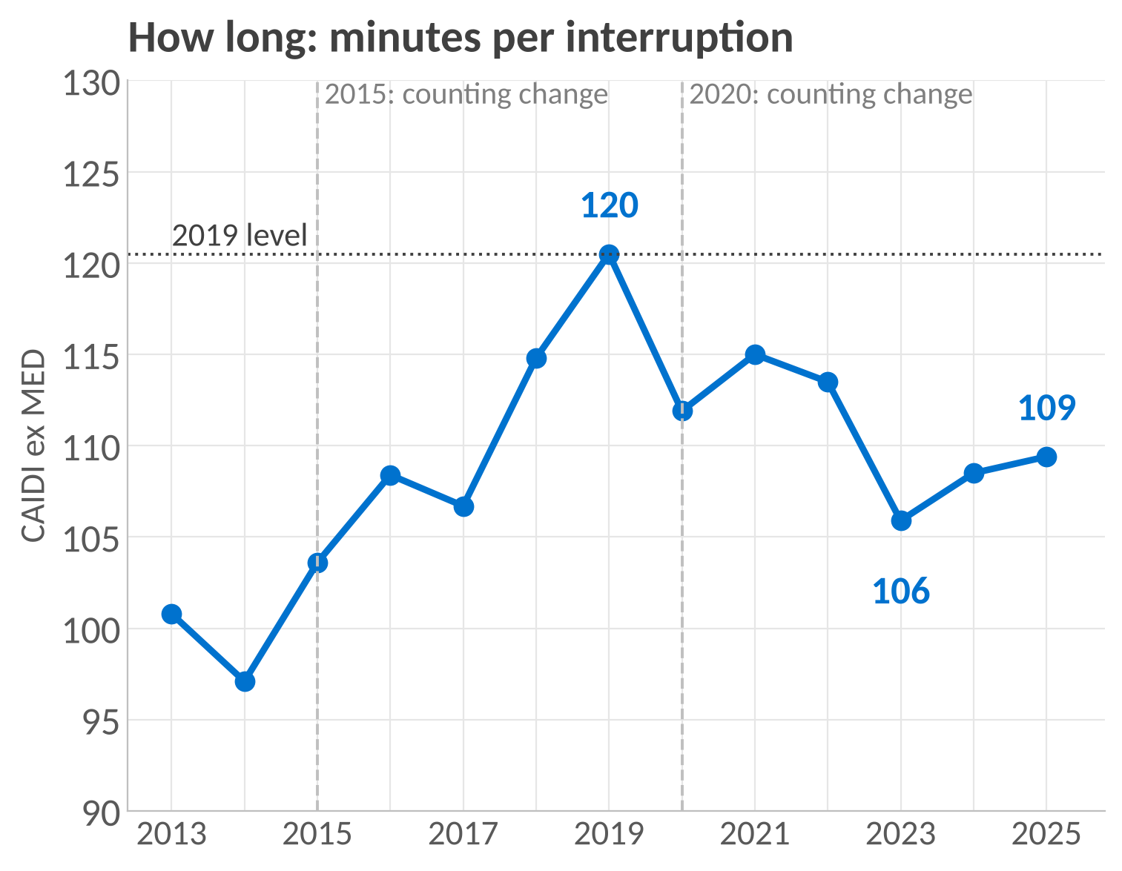
What moved, 2023 to 2025
More frequent interruptions contributed most of the rise in outage minutes. Restoration time barely changed
Outage minutes per customer (SAIDI)
Interruptions per customer (SAIFI)
Minutes per interruption (CAIDI)
Share of the change from frequency
123.3 to 144.4,
+17%
1.17 to 1.32,
+13%
105.9 to 109.4,
+3%
79%
Frequency is where to look. That needs interruptions by cause and circuit, which public data does not hold
Source: EIA-861 via PUDL 2013 to 2024, EIA-861 2025 final. Dominion Energy Virginia, excluding major event days. 79% = ln(SAIFI ratio) / ln(SAIDI ratio), a decomposition of the change, not an attribution to physical causes. Counting changes: automated outage recording (2015), 46 kV lines included (2020).
3
Notes:
Outage minutes are frequency times duration, so I split them. From 2023 to 2025, minutes per customer rose 17%. Interruptions per customer rose 13%. Minutes per interruption rose 3%. Because SAIDI is the product of the two, I can split the change in logs: 79% of it comes from frequency and 21% from duration. That is arithmetic, not a cause. The charts give the longer view. Restoration time came down from 120 minutes in 2019 to 109 and has held. Frequency fell to 1.17 in 2023 and then rose to 1.32. The dashed lines are counting changes in the EIA filing, automated outage recording from 2015 and 46 kV lines from 2020, so nobody reads a change in measurement as a change in performance. The takeaway is where to look: how often, not how long.

Slide 4
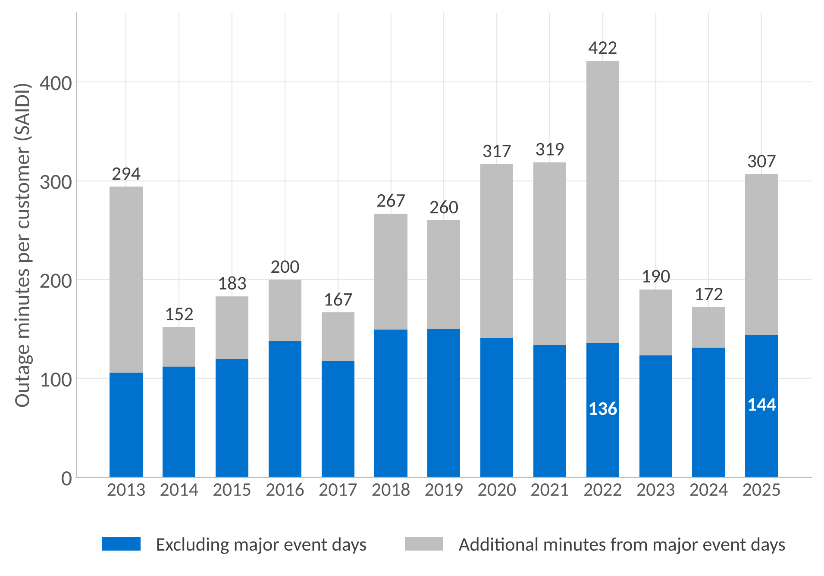
Two views of outage minutes
Major event days add a large and variable amount of outage time. Between 2022 and 2025 the total fell while the ex-MED measure rose
2022 versus 2025, minutes per customer
All events
422 to 307
Total reported outage impact fell
Excluding major event days
136 to 144
The performance measure rose
The grey segment is the difference between the two EIA figures,
2018 and 2019 also exceeded 2025 on the ex-MED measure.
Understand both total customer impact and the reporting exclusion before judging performance
Source: EIA-861 reliability, Dominion Energy Virginia, 2013 to 2025. All events and excluding major event days as filed under Dominion's own major-event rule ("Other standard").
4
Notes:
I then looked at how the major-event reporting definition changes the picture. EIA publishes two figures each year. Blue is outage minutes excluding major event days, the number the annual report tracks. Grey on top is the extra when major event days are included, and it varies a lot. Between 2022 and 2025, total outage minutes fell from 422 to 307, yet the ex-MED measure rose from 136 to 144. So one year can be worse for total customer impact and another worse on the performance measure. Both views matter when assessing reliability, and I would always report them side by side.

Slide 5
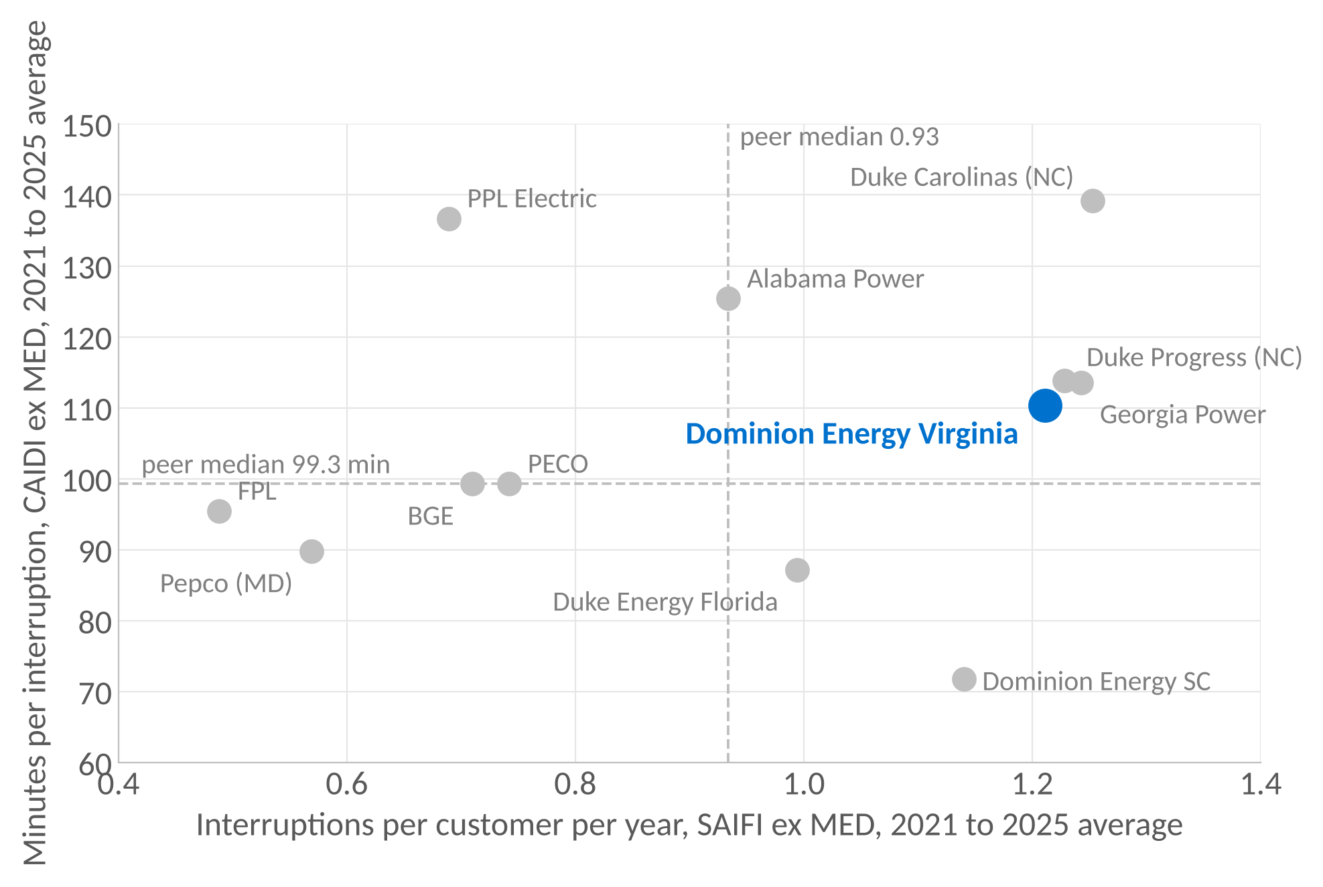
Fair comparison
Among 12 large utilities, interruption frequency is the larger gap. Restoration time is mid-pack
1.21
interruptions per customer a year. Fourth highest of the 12. Peer median 0.93
110 min
per interruption. Sixth of the 12. Peer median 99
Methods differ. Dominion files under its own major-event rule, most peers use IEEE 1366.
*Ranks are a guide, not a league table.
If frequency is where Dominion differs, the next question is which causes drive it. That needs outage records
Source: EIA-861 and PUDL, 2021 to 2025 averages of annual values, excluding major event days. Twelve investor-owned utilities in PJM and the Southeast, fixed by EIA ID before any result was computed. Medians exclude Dominion. Appalachian Power (VA) is off the chart at 1.60 interruptions and 231 minutes. Including it would move Dominion to fifth of thirteen on frequency.
5
Notes:
To see whether frequency is a Dominion thing or an industry thing, I picked twelve large investor-owned utilities in PJM and the Southeast by EIA number before I ran any results, so I could not choose a flattering set. Each dot is a five-year average. Across is how often, up is how long. The dashed lines are the medians of the eleven peers. Dominion is the blue dot. Restoration time is mid-pack, sixth of twelve, close to the median. Frequency is fourth highest at 1.21 against a median of 0.93. Two caveats I want to say before anyone asks. Dominion files to EIA under its own major-event rule, most of these peers use IEEE 1366, so the comparison is indicative. And Appalachian Power is in the peer set but off the chart at 1.6 interruptions and 231 minutes. Leaving it off is conservative, because including it would move Dominion to fifth of thirteen. The chart still says where to look, and that is how often, not how long.

Slide 6
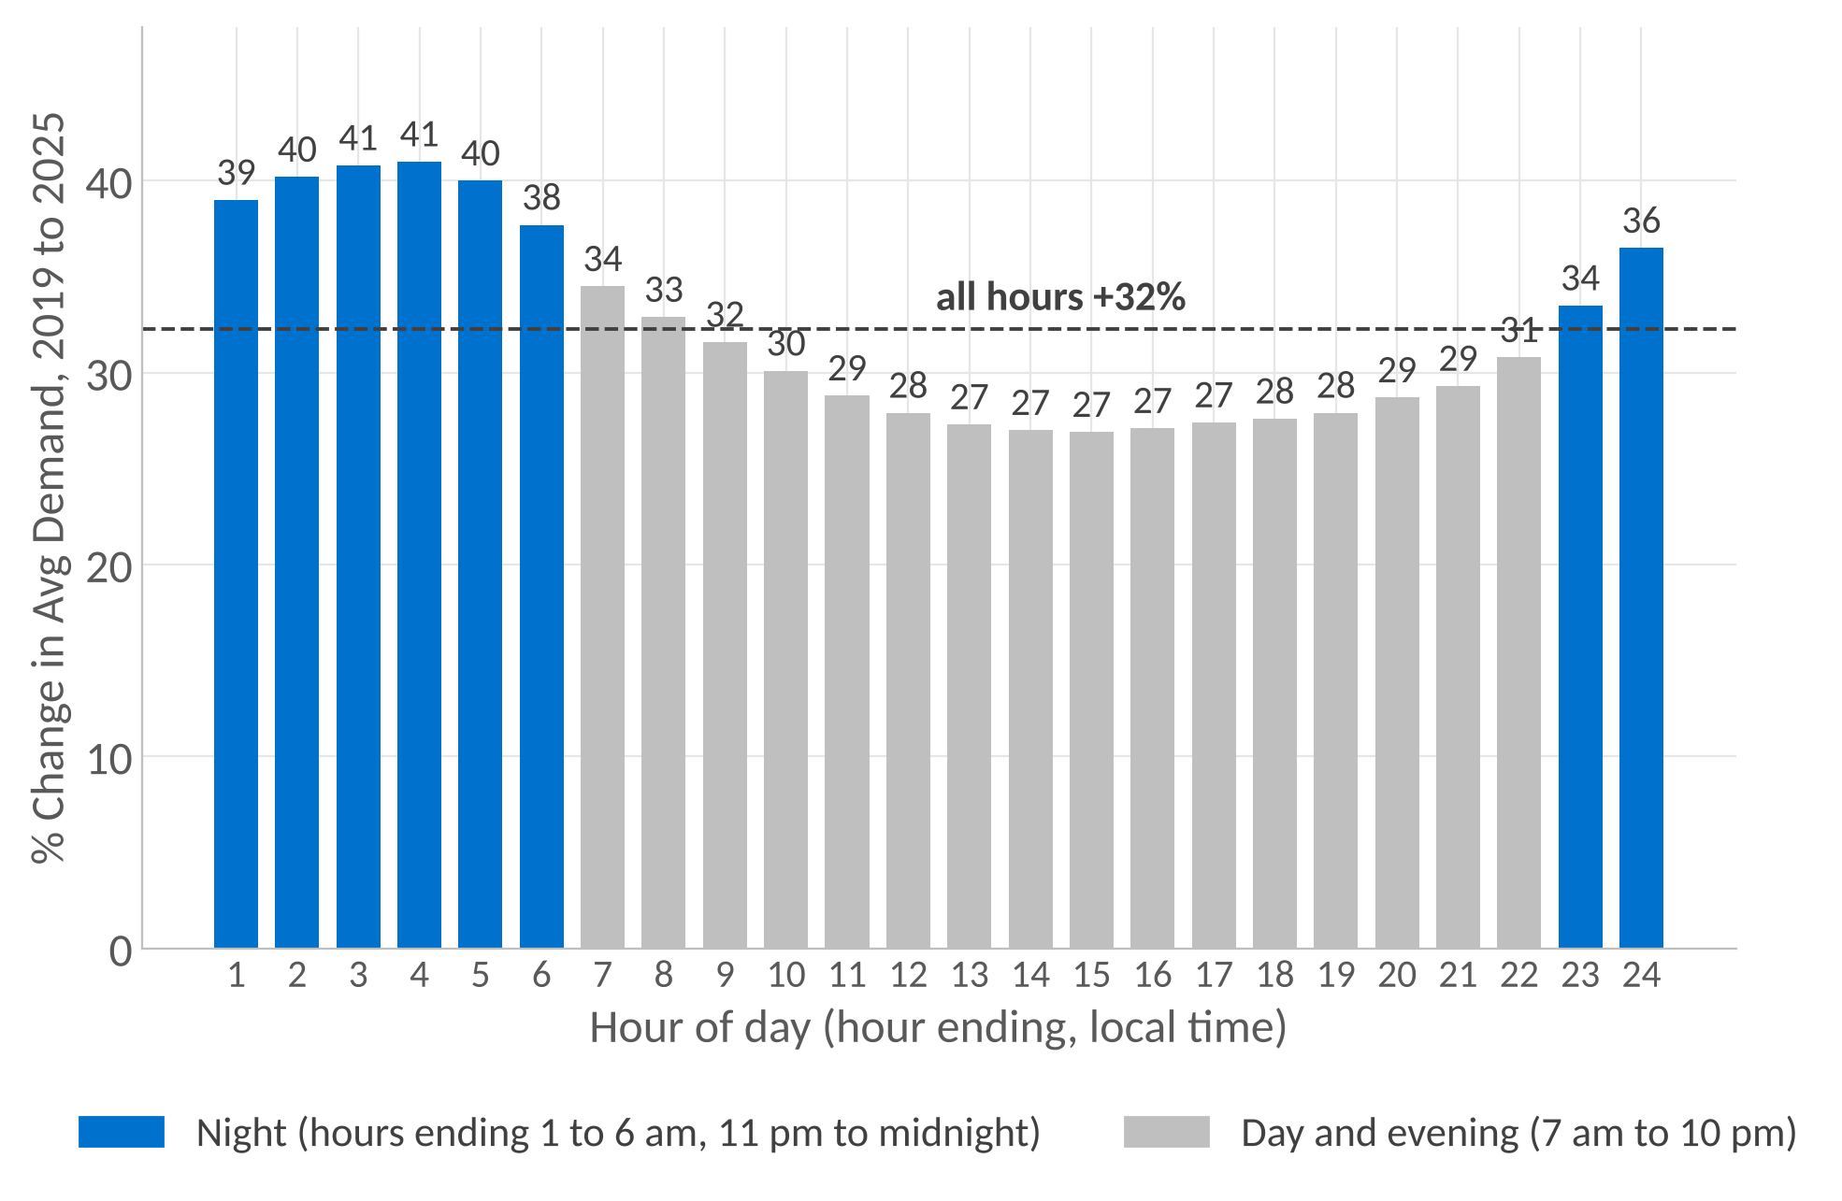
Demand on the same system
Regional demand is growing fastest overnight
+40%
average demand in the night hours (hours ending 1 to 6 am), 2019 to 2025
+27%
average demand in the afternoon hours (1 to 5 pm), 2019 to 2025. All hours: +32%
Single hours tell the same story: the lowest hour of the year rose 52% (7,167 to 10,903 MW) and the highest 26% (19,803 to 24,957 MW). Winter set the yearly peak in 2019, 2022 and 2025.
A changing load profile matters for planning. These regional figures do not show that load growth caused outages
Source: EIA-930 hourly demand, PJM DOM zone (Dominion's share of the PJM grid, wider than the Virginia retail territory), July 2018 to October 2026. Hours keyed on UTC. Two impossible readings in October 2021 excluded.
6
Notes:
Separately, I looked at hourly demand in the PJM DOM zone, which is Dominion's slice of the PJM grid and a little wider than the Virginia retail territory. The chart is growth in average demand for each hour of the day, 2019 to 2025. Overnight average demand rose about 40%, the afternoon 27%, all hours 32%. The quieter the hour, the faster it grew. Single hours say the same: the lowest hour of the year is up 52% and the highest up 26%, and 47 of the 50 busiest hours since the data began were in 2025. Winter now sets the peak as often as summer. That is a changing load profile, which matters for planning, although I cannot connect it to the reliability changes from these public datasets. I checked the zone peaks against the ones in your earnings decks and they agree within about 1%.

Slide 7
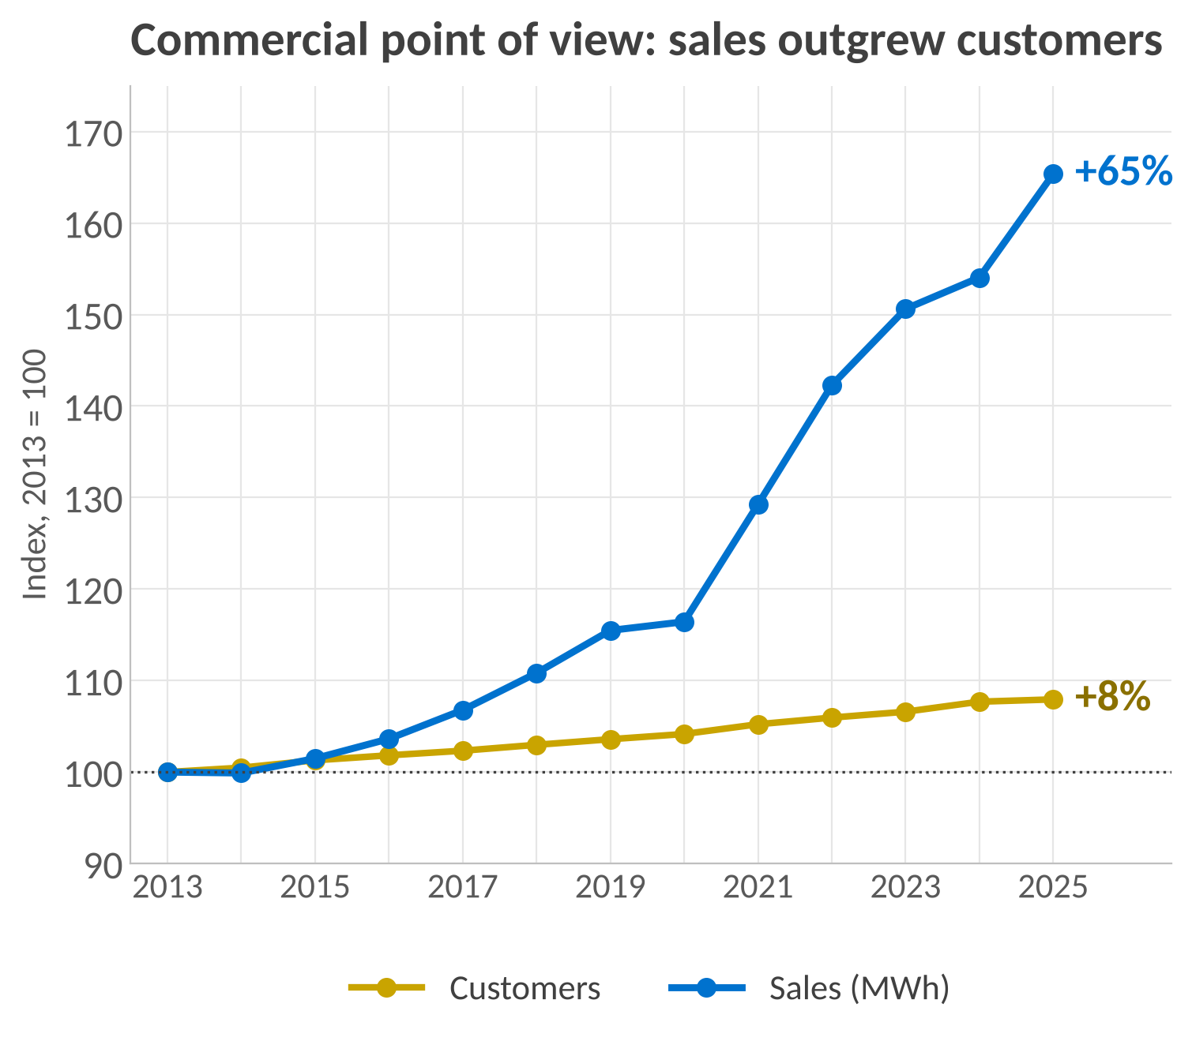
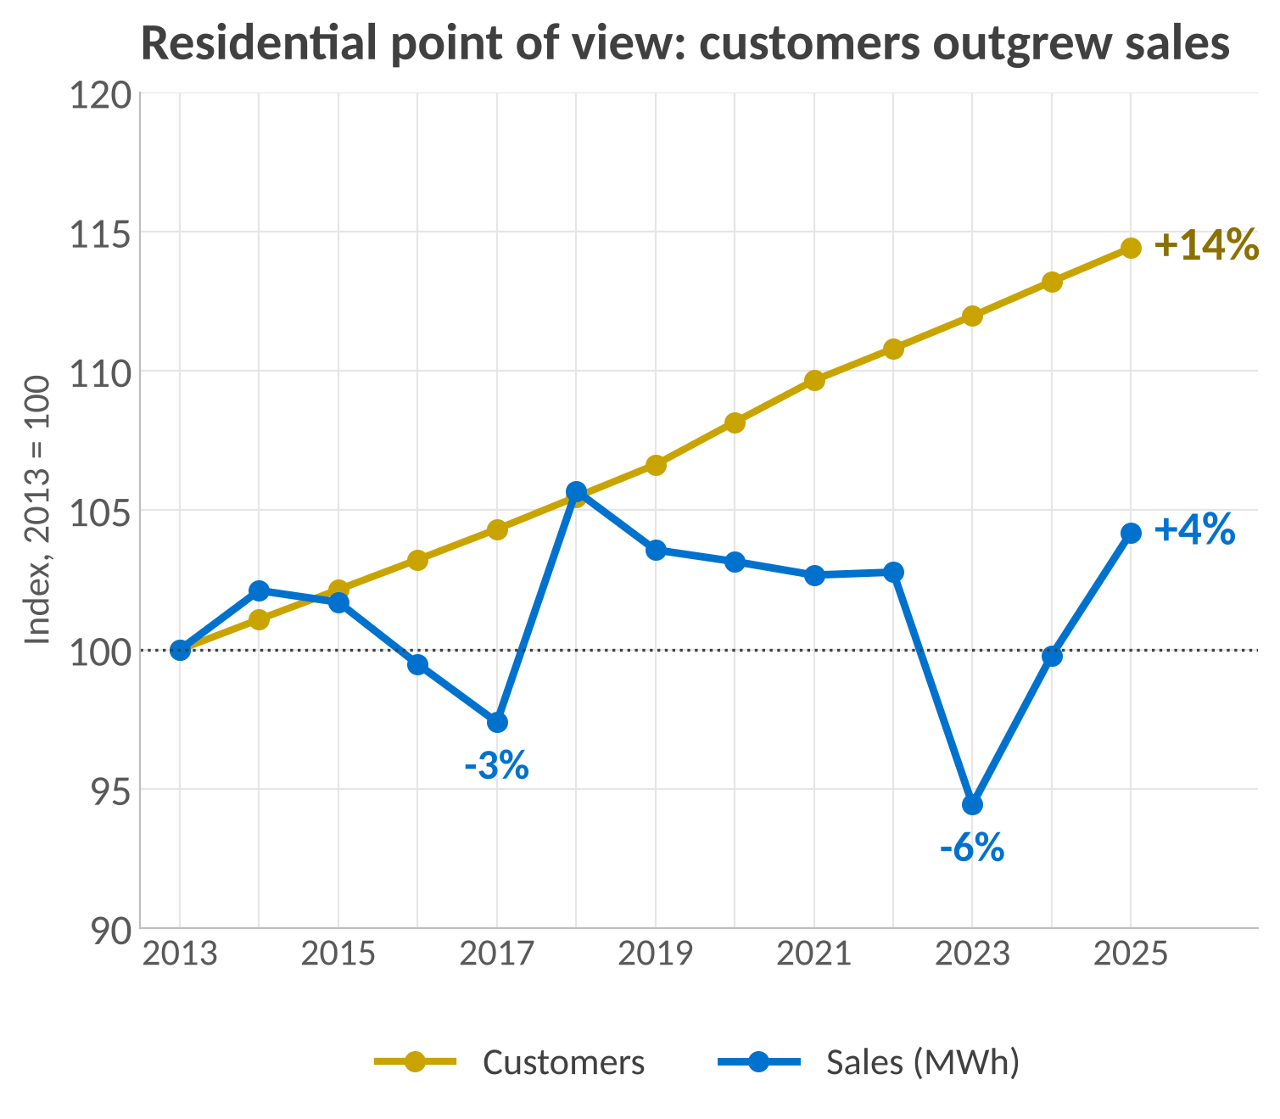
Where the growth is coming from
Commercial sales up 65% on 8% more customers.
Homes are adding customers without adding sales. Commercial is adding sales without adding customers
Source: EIA-861 sales file via PUDL, Dominion Energy Virginia, 2013 to 2025, all service types, 2013 = 100. Dominion attributes the commercial growth to data centres (2025 data centre sales 27.8 million MWh, Q4 2025 earnings deck). Residential dips in 2017 and 2023 are mild-weather years.
7
Notes:
Where is the growth coming from? EIA-861 splits sales by customer class. On the left, commercial sales are up 65% since 2013 while commercial customer numbers are up only 8%, so a small number of very large accounts are pulling the class average up. Average use per commercial customer went from about 156 to 238 megawatt hours a year. Dominion's own decks attribute that to data centres, 27.8 million megawatt hours in 2025, which is about 43% of the commercial total. On the right, the opposite pattern. Residential customers are up 14%, 300,000 more homes, but residential sales are up only 4%, and in 2017 and 2023, both mild years, sales were below the 2013 level. Use per home has fallen from about 14 to 12 megawatt hours. So the system is adding homes that use less each and a commercial segment that uses far more. That is the demand the grid has to be reliable for.

Slide 8




How it was built
Public files to a Power BI report in four steps. Every figure traces back to its source
1
2
3
4
Collect
Standardize
Calculate
Report
Load EIA-861, NOAA and EIA-930 files exactly as published. Nothing edited by hand.
One record per utility and year. Duplicates removed. Storms counted once per county per day.
Each measure defined once in SQL. Group figures customer-weighted, never averages of averages.
Power BI reads the finished tables through a read-only connection.
Why: the audit trail starts at the source
Why: five sources become comparable
Why: every chart uses the same definition
Why: a new year of data is one refresh, not a rebuild
Reconciled to the annual report: 133.0 vs 133, 130.2 vs 130
Tested after every load: 12 checks, each with its expected result
Documented: every table, column and decision, on GitHub
Reconcile first, test every load, write each definition down
Source: project repository, github.com/saketh1433/dominion-reliability-review.
8
Notes:
Briefly on how it is built. Four steps. Collect: the public files are loaded exactly as published, nothing edited by hand, so the audit trail starts at the source. Standardize: one record per utility and year, duplicates removed, storms counted once per county per day, so five sources become comparable. Calculate: each measure is defined once in SQL, and group figures are customer-weighted rather than averages of averages, so every chart uses the same definition. Report: Power BI reads the finished tables through a read-only connection, so a new year of data is one refresh, not a rebuild. Underneath that, three habits. The figures reconcile to the annual report. Twelve checks run after every load with the expected result written beside each one. And everything is documented on GitHub. Those are the habits I would bring to the team's reports.

Slide 9


With Dominion's own data
The first 90 days: turn the public-data questions into decision support
Days 1 to 30
Days 31 to 60
Days 61 to 90
Learn and reconcile
Ask about frequency
Build the tracking report
Learn how outages, meter events and circuits are recorded. Rebuild one year's SAIDI, SAIFI and CAIDI from the outage system and tie them to the filed figures.
Interruptions by circuit and cause code, storm days apart from calm days. Are calm-day interruptions rising underneath the storms. Repeat interruptions per customer.
A Power BI report that shows reliability beside storm exposure, so a stormy year is never read as a trend, and tracks hardened circuits against comparable untreated ones.
Needs: outage records by event, circuit and cause. Meter last-gasp and restore messages
With: the people who own each definition. Questions to check, not conclusions
Public data found the question. Internal data answers it
9
Notes:
Public data gets you to the right question. It cannot answer it, because it has one number per utility per year and no causes or circuits. So this is what I would do with your data. First month, learn how outages and meter events are recorded and rebuild one year's figures so I trust the baseline and the definitions are written down. Second month, split interruptions by cause and circuit, storm days apart from calm days, and ask the question this whole review points at: are calm-day interruptions rising underneath the storms. Third month, a Power BI report that puts reliability next to storm exposure, so nobody reads a stormy year as a trend, and that tracks hardened circuits against comparable ones. These are questions to take to the people who own the definitions, not answers I am bringing in.

Slide 10
Three takeaways
1
2
3
The rise is real and it is 2025
Frequency is the measure to watch
The load is growing overnight
130 to 133 is 2025 replacing 2022. Between those two years total outage impact fell (422 to 307) while the ex-MED measure rose (136 to 144), so both views are needed.
The lowest hour of the year is up 52%, the highest 26%, and 47 of the 50 busiest hours on record were in 2025.
Frequency contributed 79% of the 2023 to 2025 rise. Restoration is mid-pack among peers, frequency is fourth highest of twelve. Why needs outage records by cause and circuit.
Thank you. I would like to do this work with your team.
Notes:
Three things to take away. One, the reported rise is real and it is one year, 2025 replacing 2022. Between those two years total customer impact fell while the performance measure rose, which is why both views should be reported together. Two, frequency contributed most of the recent rise, restoration is mid-pack, and understanding why needs outage records by cause and circuit, which is where I would start. Three, the load the system carries is growing fastest overnight, which is structural growth, not weather. Everything is public and the code and tests are on GitHub. Thank you, and I would like to do this work with your team.

Slide 11
Appendix 1. Sources and tests
Every number traces to a public file. Twelve tests run after each load with the expected result stated
Source | Publisher | Years | One row is | Rows
EIA-861 Reliability, 2025 final | EIA | 2025 | utility, state, year | 977
EIA-861 reliability, meters, sales via PUDL | Catalyst Cooperative | 2013 to 2024 | utility, state, year | 24,358
EIA-861 Service Territory | EIA | 2025 | utility, county | 11,803
NOAA Storm Events | NOAA NCEI | 2013 to 2025 | one storm report | 831,288
NWS zone to county lookup | National Weather Service | current | forecast zone, county | 7,087
EIA-930 hourly demand, subregions | EIA | Jul 2018 to Oct 2026 | subregion, hour | 6,077,232
Dominion Energy 2025 Annual Report, earnings decks | Dominion Energy | 2024 to 2026 | figures quoted for comparison | reference
Tests T1 to T12, result on this build
Storms and demand
T1 no duplicate key (0). T2 SAIDI = SAIFI x CAIDI within 2% (0). T3 all-events not below ex MED (4 known source anomalies, outside the peer set). T4 Dominion 2025 equals the EIA file (0). T5 row counts by year (13). T6 no number lost in parsing (0).
T7 every Dominion county resolves to a FIPS code (0 unresolved). T8 latest NOAA file covers a full year (December). T9 no zone event left without a county (0). T10 hours above 60,000 MW (2 known, October 2021). T11 no UTC hour twice (0). T12 each full year has at least 8,700 hours (0 short).
Source: project repository, docs/01 sources register and docs/03 data quality. PUDL data is CC-BY 4.0. All other sources are US government publications.
A1
Notes:
Sources and tests. Five public datasets plus Dominion's own published figures for comparison. The tests are plain SELECT statements that return the expected row count when the data is sound, so anyone with read access can run them, and the expected result is written beside each one. Two tests flag known source issues on purpose, four EIA rows where all-events SAIDI is below ex MED and two impossible demand readings in October 2021. A flag is a reason to investigate, not a reason to delete.

Slide 12
Appendix 2. What public data cannot show
And what would answer it
Public data limit | What would answer it (Dominion data, by type)
One number per utility per year (EIA-861) | Outage records by event, circuit and cause
Storms counted by county, not by line | Outage records with cause codes and circuit location
Major-event methods differ between utilities | Dominion's daily SAIDI and its filing method
The DOM zone is wider than the retail territory | Meter interval data by circuit and customer class
No customer identities, so load growth cannot be attributed | Customer class and large-load records
Hardening coverage and per-circuit effect are not published | Programme records: circuits treated, dates, pre and post performance
Source: project scope limits, docs/04 decisions and docs/03 data quality.
A2
Notes:
The limits, stated plainly. Public data has one number per utility per year, counts storms by county rather than by line, and cannot see causes, circuits or customers. Each row on the left names the Dominion data type that would answer it. I have been careful with words throughout: consistent with weather rather than caused by, no visible trend rather than flat or improving, and peer ranks as a guide because methods differ. Nothing internal and nothing from my employer was used.

Slide 13
Appendix 3. Definitions
SAIDI = SAIFI x CAIDI, and major event days are set aside by rule
SAIDI
SAIFI
CAIDI
=
Customer interruptions divided by customers served. How often the average customer is interrupted
x
Customer minutes interrupted divided by customer interruptions. How long the average interruption lasts
Outage minutes per customer per year. The headline measure
Dominion 2025: 1.320 x 109.4 = 144.4 minutes, excluding major event days
Term | Meaning in this review
Major event days (MED) | The few extreme days a utility sets aside when reporting. IEEE 1366 uses a statistical threshold on five years of daily SAIDI. Dominion files to EIA under its own rule ("Other standard"), most peers under IEEE 1366
All events vs ex MED | With major event days, Dominion's 2025 SAIDI was 306.7 minutes. Without them, 144.4. Major event days held 53% of all minutes
Customer-weighted | Group figures sum customer-minutes and customer-interruptions across utilities and divide once. Never an average of ratios
Storm county-day | One county with at least one NOAA wind, winter or tropical storm report on one date, counted once however many reports it produced
Three-year average | Mean of three annual SAIDI ex MED values, as in the annual report. Rebuilt: 133.0 (2023 to 2025) and 130.2 (2022 to 2024)
Source: IEEE Std 1366. EIA-861 reliability file, Dominion Energy Virginia, 2022 to 2025.
A3
Notes:
Definitions, if anyone wants them. SAIDI is minutes per customer per year, and it is the product of how often, SAIFI, and how long, CAIDI. For Dominion in 2025 that is 1.32 interruptions times 109 minutes, 144 minutes. Major event days are the extreme days a utility sets aside when it reports. IEEE 1366 defines them statistically. Dominion files under its own rule, which I only know from the EIA filing, not from Dominion documentation. Every group figure in this deck is customer-weighted, I never average ratios.

Slide 14
Appendix 4. The weather fit
A check on one year, not a forecast
Year | Storm county-days | SAIDI ex MED | From the fit | Adjusted
2015 | 526 | 119.6 | 131.4 | 122.2
2016 | 597 | 138.2 | 135.0 | 137.2
2017 | 420 | 117.4 | 126.0 | 125.5
2018 | 687 | 149.6 | 139.7 | 143.9
2019 | 851 | 149.9 | 148.1 | 135.8
2020 | 431 | 141.0 | 126.5 | 148.5
2021 | 676 | 133.6 | 139.1 | 128.5
2022 | 723 | 136.0 | 141.5 | 128.5
2023 | 391 | 123.3 | 124.5 | 132.9
2024 | 465 | 131.3 | 128.3 | 137.0
2025 (predicted) | 796 | 144.4 | 145.3 | 133.1
Fit on 2015 to 2024, ten points: SAIDI = 104.4 + 0.0514 x storm county-days. Correlation 0.70, R squared 0.48. Mean of the fit years 134.0.
Why 2015: the EIA filing flag for automated outage recording changes that year and the level shifts with it. 2013 and 2014 are shown on charts but kept out of the fit.
Adjusted = actual less (fitted less 134.0), each year standardised to average storm exposure. Stormy years adjust down, calm years up. Its slope over 2015 to 2025 is +0.35 minutes a year, not distinguishable from zero on eleven points. Exploratory, not a measure of true underlying reliability.
Limits: ten annual points, no control for vegetation, equipment age or programme spend, and storm reports are a proxy for severity. The mechanism (storms damage lines) is known. The fit sizes it, it does not prove it.
Source: NOAA Storm Events and EIA-861, 2015 to 2025. Ordinary least squares, MART.SAIDI_WEATHER_ADJUSTED in the project repository.
A4
Notes:
The full fit table, in case someone asks how robust it is. Ten points, correlation 0.70, R squared about half. Residuals run from minus twelve to plus fourteen minutes, so a single year can be off by that much, which is exactly why I say the fit is a check on one year and not a forecast. 2025 lands within a minute. What I would not claim is causation from ten points. What I can say is that the known mechanism, storms damage lines, is sized at about a twentieth of a minute per county-day, and that once it is removed nothing is left trending.

Slide 15
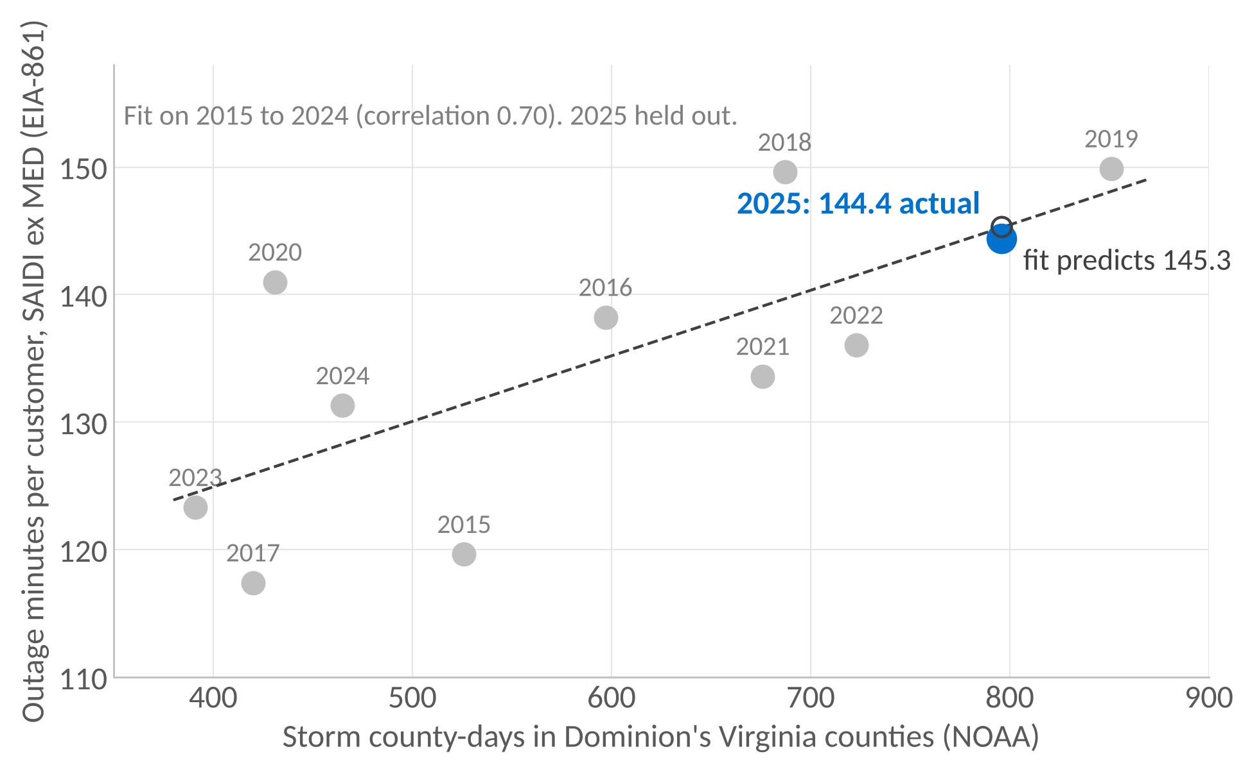
Appendix 5. Weather and outage minutes
2025 SAIDI was consistent with the historical storm-exposure relationship
145.3
2025 estimate from its storm count, using a line fitted on 2015 to 2024 only
144.4
2025 reported
Storm county-days: 391 in 2023, 465 in 2024, 796 in 2025. Correlation 0.70 on ten annual points. Each additional county-day is associated with about 0.05 more minutes.
The regression found a positive association. It cannot isolate weather's causal impact
Source: NOAA Storm Events (wind, winter and tropical events, one count per county per day, Dominion's 104 Virginia counties and cities) and EIA-861, 2015 to 2025. Ordinary least squares on ten annual points, 2025 held out. A statistical association, not a measured physical effect.
A5
Notes:
So was 2025 the weather? To measure weather I used NOAA storm reports. One county with at least one wind, winter or tropical storm report on a day counts once, so a storm that produces ten reports in Chesterfield on the same evening is one county-day. Storm county-days went from 391 in 2023 to 796 in 2025, they doubled. I fitted outage minutes against storm county-days over 2015 to 2024 and held 2025 out as a test. The fit estimated 145.3 minutes for 2025's storm count. The reported figure was 144.4. The correlation is 0.70 on ten points, so I treat this as context, not proof. What it says is that 2025 is where the last ten years of weather would put it. What it cannot say is which minutes came from storms and which from anything else, because the model has no vegetation, equipment or spend in it.

Slide 16
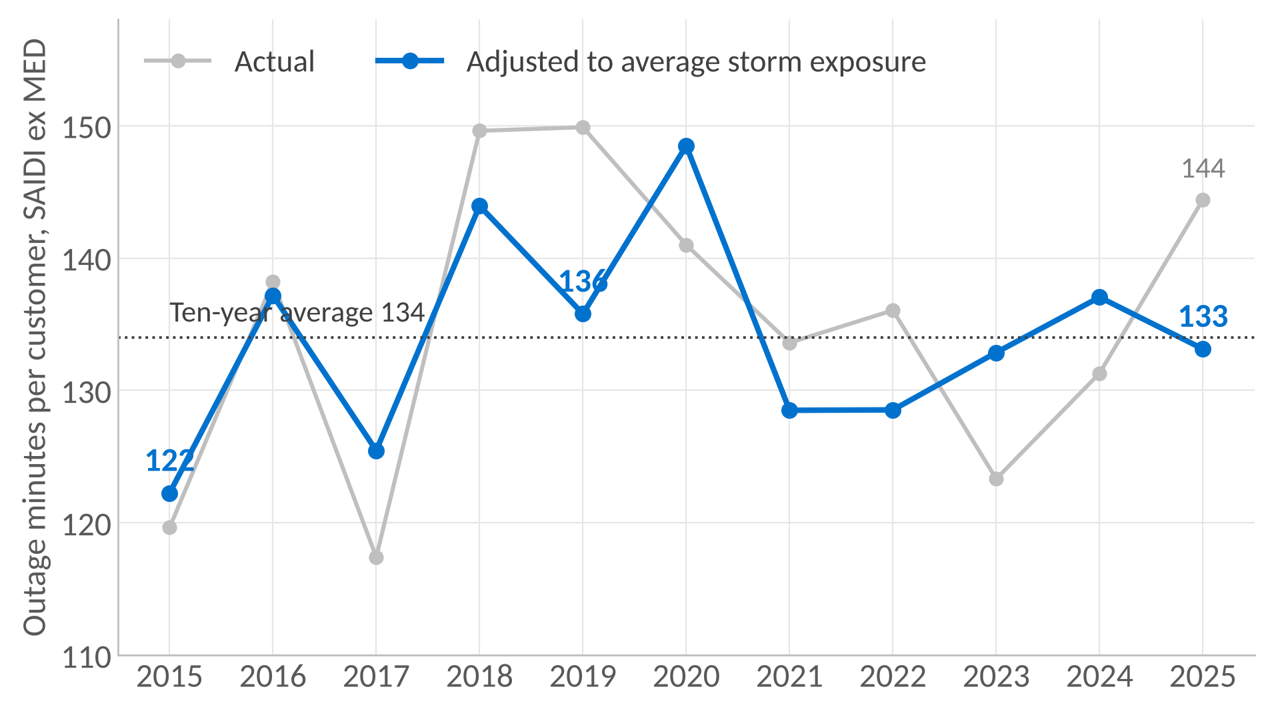
Appendix 6. Model-adjusted SAIDI standardised to average storm exposure
An exploratory regression-based comparison, not a causal estimate of weather-related outage minutes
How it is built: adjusted = actual SAIDI less (fitted SAIDI for the year's storm count less 134.0, the 2015 to 2024 mean). Years with more storms than average are adjusted down, years with fewer are adjusted up.
Example, 2023: actual 123.3, few storms (391 county-days), adjusted 132.9. The blue line sits above the grey because 2023 had less storm exposure than the reference average.
What it shows: the adjusted series runs from 122 to 149 across 2015 to 2025 with a slope of +0.35 minutes a year. 2025 adjusted is 133.1. These are standardised comparisons on a ten-point fit, not observed minutes with weather removed.
Used only to check whether anything beyond storm exposure stands out in the series. On this fit, nothing does
Source: EIA-861 and NOAA Storm Events, 2015 to 2025. Fit on 2015 to 2024 (Appendix 2). 2013 and 2014 excluded because the filing's outage-recording flag changes in 2015.
A6
Notes:
If asked about weather normalisation. This standardises each year to an average storm year using the fit in Appendix 2. Stormy years are adjusted down, calm years up, so 2023 with very few storms moves from 123 to 133. The adjusted series runs between 122 and 149 and its slope is a third of a minute a year. I treat this as exploratory, a check for anything beyond storm exposure that stands out, and on this fit nothing does. I would not present it as a measure of true underlying reliability, because it rests on ten annual points and a single explanatory variable.

Slide 17
Appendix 7. Restoration after large outages
Recovery times varied between periods. The trend is not statistically conclusive
Median hours from the outage peak to 90% of customers restored
2015 to 2019
2020 to 2025
19.6 h
23.5 h
After accounting for the size of each outage
+4.6%
-0.5% to +9.8%
estimated change in recovery time per year
95% confidence interval. The range includes no change
The estimate points to longer recoveries. The evidence is not strong enough to call it a deterioration
Source: EAGLE-I (Oak Ridge National Laboratory for DOE), 47 outage episodes with at least 50,000 customers out for one hour, 2015 to 2025. Counts every utility in Dominion's counties, not Dominion alone. Recovery is a net count of customers out, not verified restoration times. Not comparable with CAIDI.
A7
Notes:
If asked whether restoration after big storms has changed. I used EAGLE-I, a federal dataset that counts customers without power in every county every fifteen minutes. I took the 47 episodes since 2015 where at least 50,000 customers were out for an hour and measured how long it took to get 90% of them back. The median rose from about 20 hours in 2015 to 2019 to about 23 and a half in 2020 to 2025. But bigger outages take longer by nature, so I adjusted for the size of each event. The adjusted trend is plus 4.6% a year with a 95% interval from minus 0.5% to plus 9.8%. That range includes zero, so I cannot say recovery has got worse, only that it has not clearly got better. Three limits: it is every utility in those counties, not Dominion alone, it is a net count rather than verified restoration times, and 47 events is not many. That is why it is in the appendix and not the main findings.

